Slide 1
Red Light Running in Western Puerto Rico
Colleen Grinham
Eisenhower Transportation Fellowship
Notes:
Hello my name is Colleen Grinham
I am a civil engineering major at the University of Rhode Island here at UPRM in an exchange hosted by the Eisenhower Transportation Fellowship.
This summer I worked with Fabiola Buitrago on her PhD thesis in Transportation engineering.
The project involved Red Light Running in Western Puerto Rico.

Slide 2
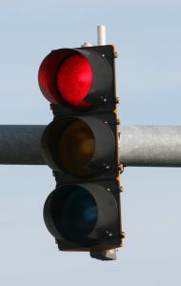
Red-Light Running: The Problem
Red-Light Running (RLR) is the cause of
  More than 100,000 crashes
  1,000 deaths
  And an estimated $14 Billion
annually.
Notes:
My project started out with a literature review on Red Light running and past studies surrounding the material.
Since this is the first time I’ve worked with transportation engineering, this was all new material to me.
I was responsible for compiling all of the information that I has research in a formal literature review.
READ SLIDE

Slide 3
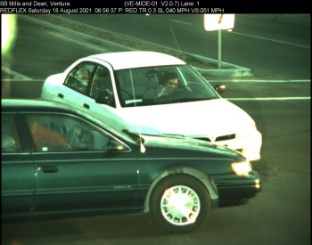
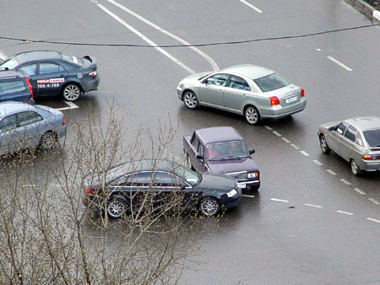
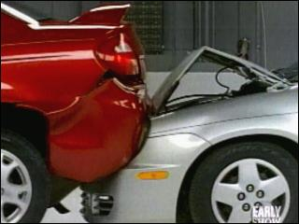
Three Types of RLR Crashes
Lateral
With Turning
Rear End
Notes:
There are 3 types of crashed involved in RLR.
LATERAL: where a driver runs the red light and hits another movement of traffic.
REAR-END: where a driver short stops in order to avoid running the red light, not giving the driver behind him ample warning resulting in a crash.
And WITH TURNING: where a driver is turning through an intersection after the light has changed to red and collides with another movement of traffic.
Occupant injuries occurred in 45% of RLR crashes compared to the 30% of occupant injuries in other types of crashes.

Slide 4
Two Types of Red-Light Runners
Intentional Red-Light Runners
  These drivers are usually aggressive, impatient, or have a disregard for the laws and consequences of RLR.
Unintentional Red-Light Runners
  These drivers usually are in a situation where the light signal was not clearly visible or the yellow signal was not long enough to come to a stop.
“In a nationwide survey of 880 licensed drivers, one in five respondents reported running one or more red lights when entering the last 10 signalized intersections.”
Notes:
READ SLIDE:
READ QUOTE:
Site as from the study of "Reducing red light running through longer yellow signal timing and red light camera enforcement: Results of a field investigation." by Retting, Ferguson, and Farmer.

Slide 5
The Three E’s
Engineering
Education
Enforcement
Notes:
The solution to RLR is the Three Es. Engineering, Education, and Enforcement.
Engineering solutions pertain mostly to unintentional RLRs. This could include such solutions as changing the location of the lights or type of light; signaling ahead for intersections; changing the geometry by adding more “solo” lanes; or by changing the light times such as increasing the time of the yellow light.
Education solutions would effect both intentional and unintentional RLR. These would include enlisting public service announcements and other media tools addressing the problem of RLR with the public. A target audience for these measures are new drivers. Also, alerting the public to an increased level of enforcement pertaining to RLR is threat enough to discontinue unlawful and dangerous behavior.
The third E, is enforcement. Many intentional RLR feel that there is little to no consequences for RLR. Installing RLC will drastically decrease the amount of RLR occurrences. RLC have been known to decrease RLR violations by 40-50% and reduces crashes caused by RLR 25-30%. This was determined by a study done by the Insurance Institute for Highway Safety.

Slide 6
This summer I…
Worked on obtaining data toward the doctoral dissertation of Fabiola Buitrago González.
  This thesis in its initial phase involves Red-Light Running in Mayagüez, and other surrounding western areas of Puerto Rico.
  The goal is to determine the factors that affect Red-Light Running and its frequency in this region.
Notes:
READ SLIDE

Slide 7
Tasks :
My main task of this project was in two parts; on-sight field work at intersections, and post field work video analysis
Field Work
  Recording two approaches of an intersection with a standard video camera for one hour each.
  Taking vehicle free-flow speed data with the speed gun.
Video Analysis
  Reviewing all four approaches’ video data.
  Taking volume counts of all movements every 5 minutes
  Timing light cycles
  Counting vehicles which ran yellow lights and red lights during each cycle
Notes:
READ SLIDE:

Slide 8
How the intersections were chosen
Based on the Crash Data-Base
Intersections with high number of RLR related accidents
5 Intersections.
  Four 4 way intersections, One “T” intersection
  Total of 19 approaches
Notes:
READ SLIDE

Slide 9
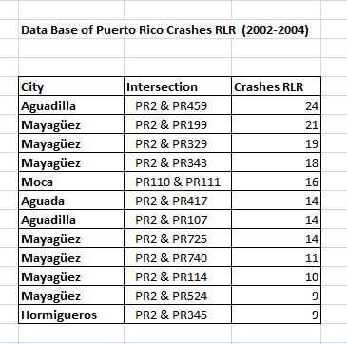
Crash Data Chart
Notes:
This Chart was created by Fabiola Buitrago after analyzing the crash data base for Puerto Rico. After reviewing certain factors from accidents from police reports, this chart was created showing accidents that were RLR related. The intersections in western Puerto Rico were then arranged in order from most accidents to least. Intersections with high RLR accidents were targeted for field research.
The intersections with the blue arrows are intersections where field data was collected from.
Please note that the intersections of PR 2 with PR 199 and PR 329 do not exist in Mayaguez. This was a result of an error in the crash data base.

Slide 10
Our intersections were also chosen based on the data of Kathleen Diaz’s M.S. thesis.
Her thesis determined the most unsafe intersections in western Puerto Rico.
All of our intersections were on her data as being some of the most dangerous.
Notes:
READ SLIDE:

Slide 11
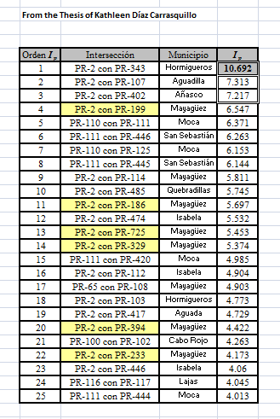
Kathleen Diaz’s
Thesis Chart
Notes:
The blue arrows once again show the intersections that we collected data from.
Only intersections that occurred on both Kathleen Diaz’s chart, and the chart created from the crash database were taken into consideration in this research.

Slide 12
Where were our intersections?
Aguadilla (2)
Aguada
Mayagüez
Hormigueros
All of our intersections involved PR 2 as the main approach
Notes:
READ SLIDE:

Slide 13
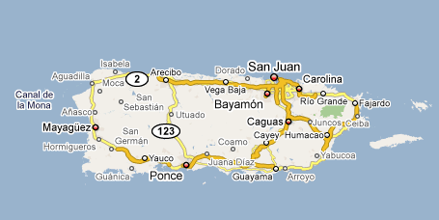
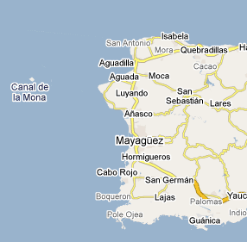
2
N
PR
Notes:
This is a map of where exactly our intersections were.

Slide 14
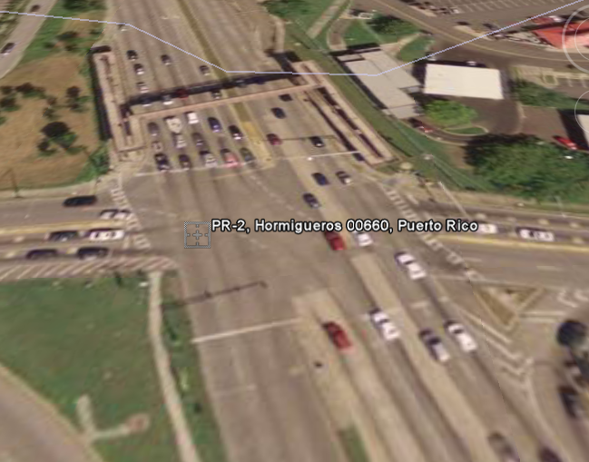
PR 2 + PR 343
Hormigueros
Notes:
Four Approaches.
Special approaches of interest. PR is a very busy route, but you also have mall traffic.

Slide 15
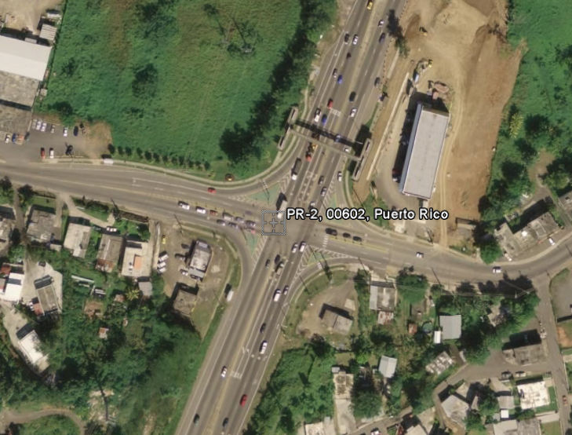
PR 2 + PR 417
Aguada
Notes:
4 approaches.
This intersections had especially heavy truck usage.

Slide 16
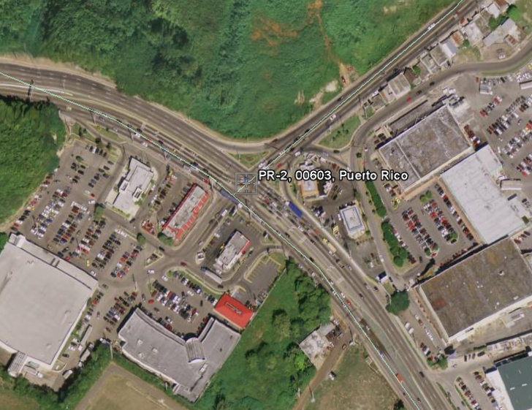
PR 2 + PR 459
Aguadilla
Notes:
4 approaches. 3 Routes and a shopping plaza

Slide 17
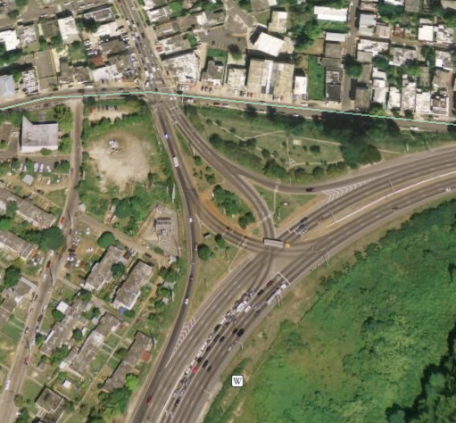
PR 2 + PR 107
Aguadilla
Notes:
3 approaches. All very busy. PR 2 and the route to popular beaches and the aguadilla airport.
There was frequent over flow into this intersections from the traffic stopped at an intersection further down PR 107.

Slide 18
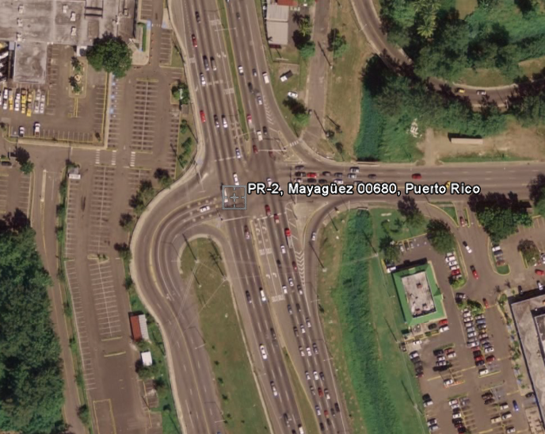
PR 2 + PR 114
Mayagüez
Notes:
4 approaches.
PR 2 is a main route.
Weat approach (PR 114) was the entrance to the dtop which is also busy.

Slide 19
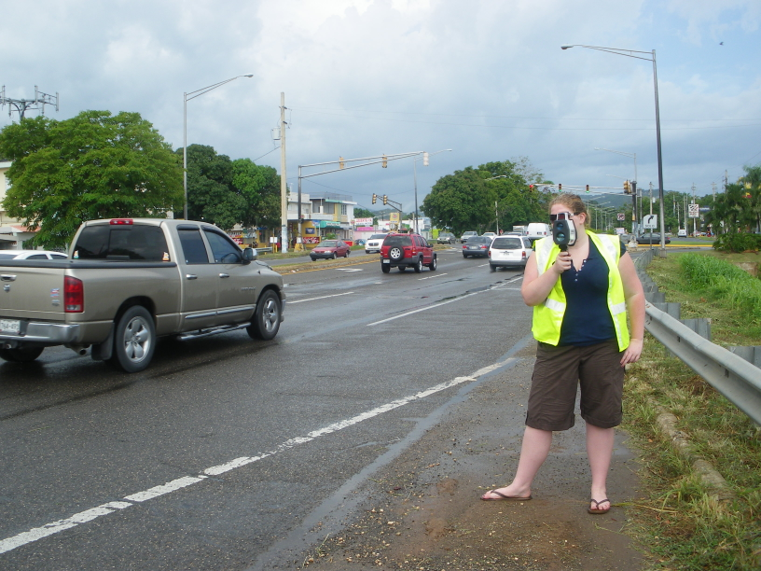
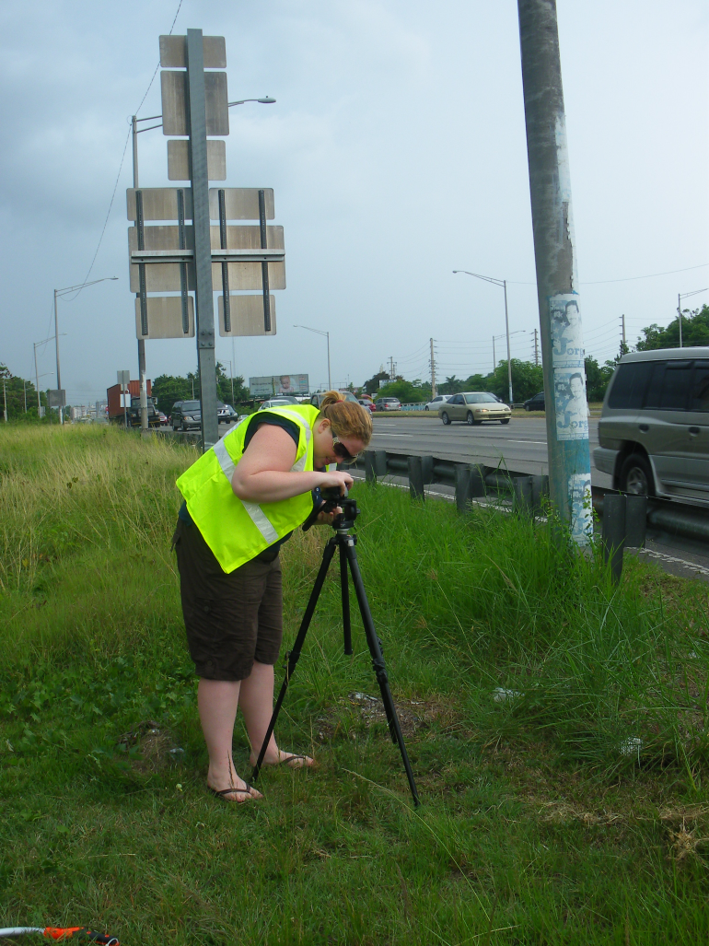
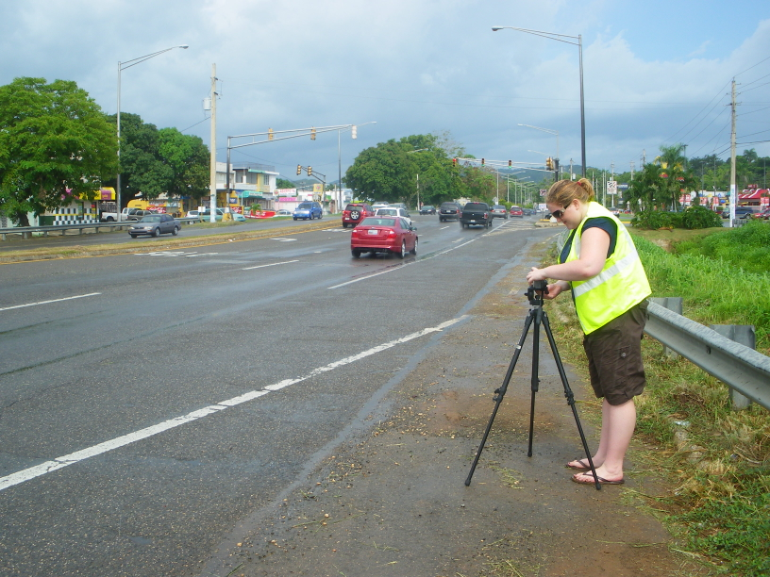
In the Field…
Notes:
This was my first experience with any type of field work, especially transportation field work. So everything that I did here, I has just learned. About 85% of this project was field work.

Slide 20
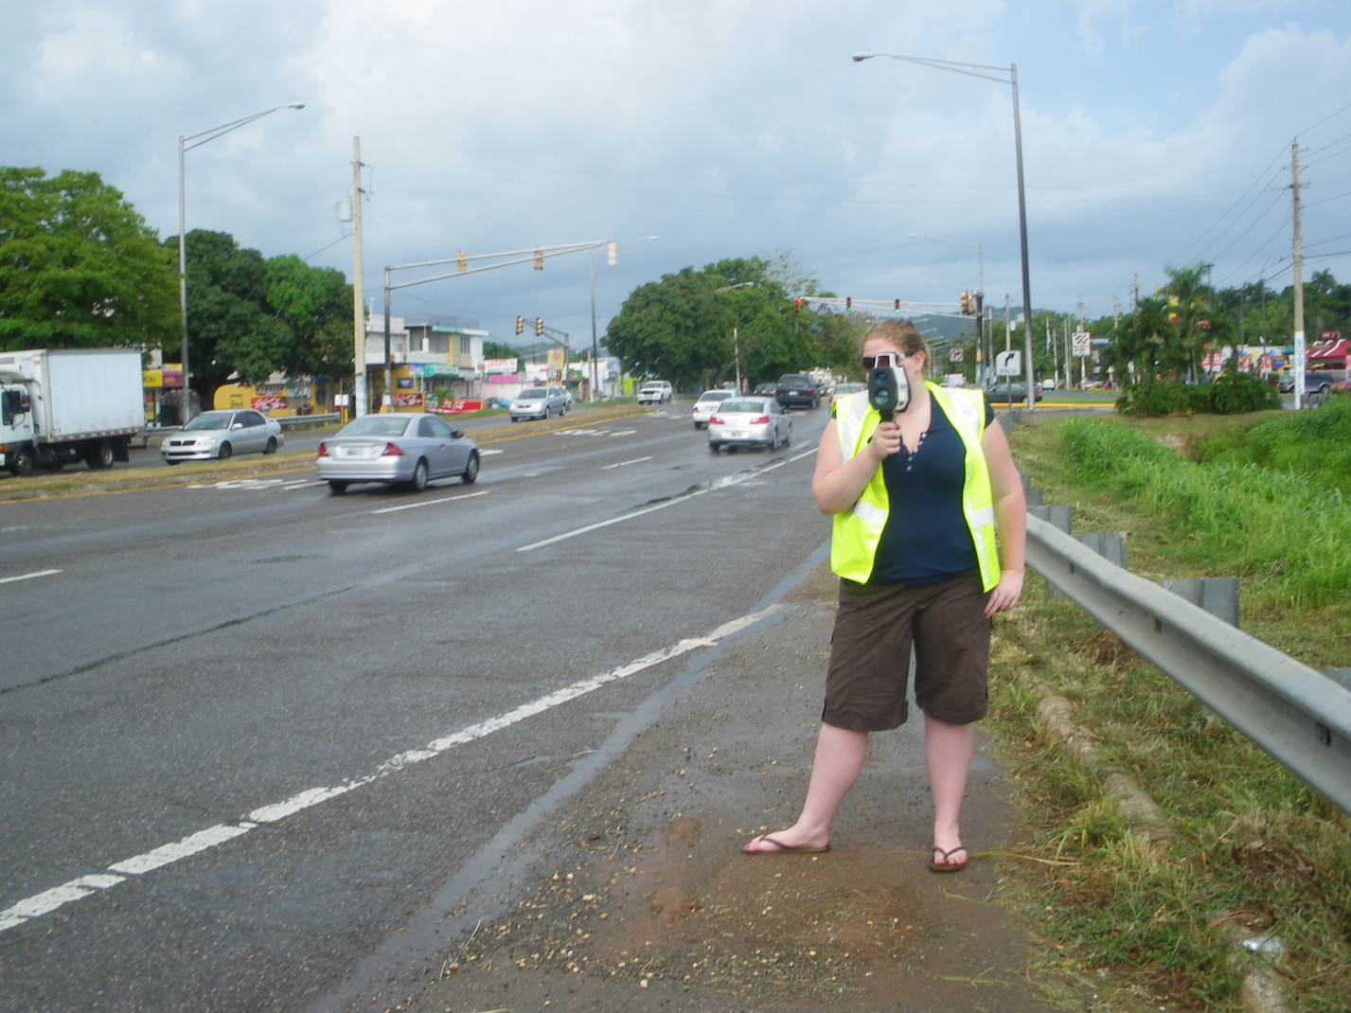
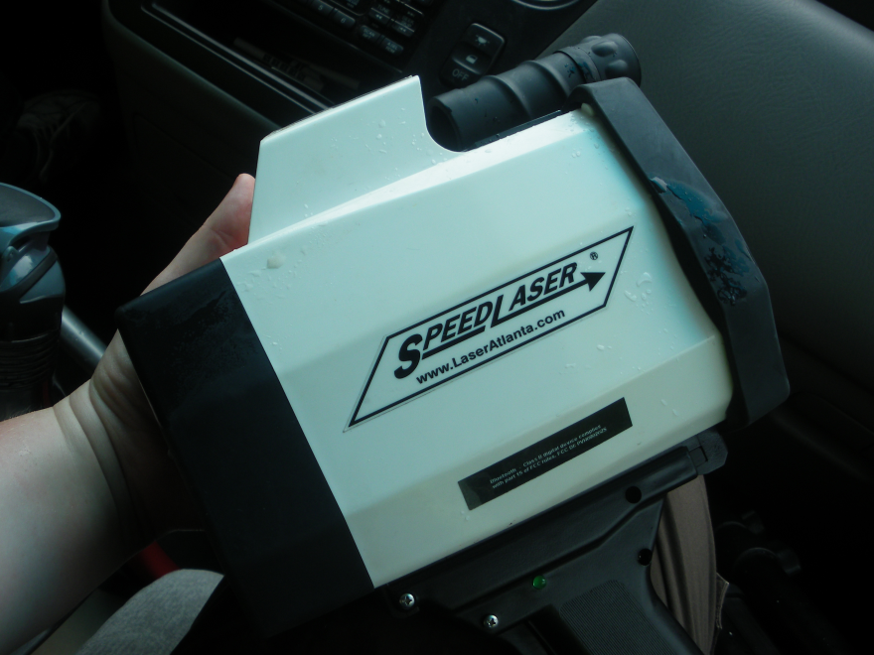
Taking Speed Data
One of my main field tasks was the record at speed data of vehicles in free flow chosen at random.
Notes:
READ SLIDE:
To do this I used a “SpeedLaser” by Atlanta laser standing around 100ft away from the stop line of the approach. I would record the Distance the car was away from me, the type of car (Sedan, SUV, or Pick-Up), the speed of the car, and the lane which the car was in. Only the first car in a “platoon” was recorded.

Slide 21
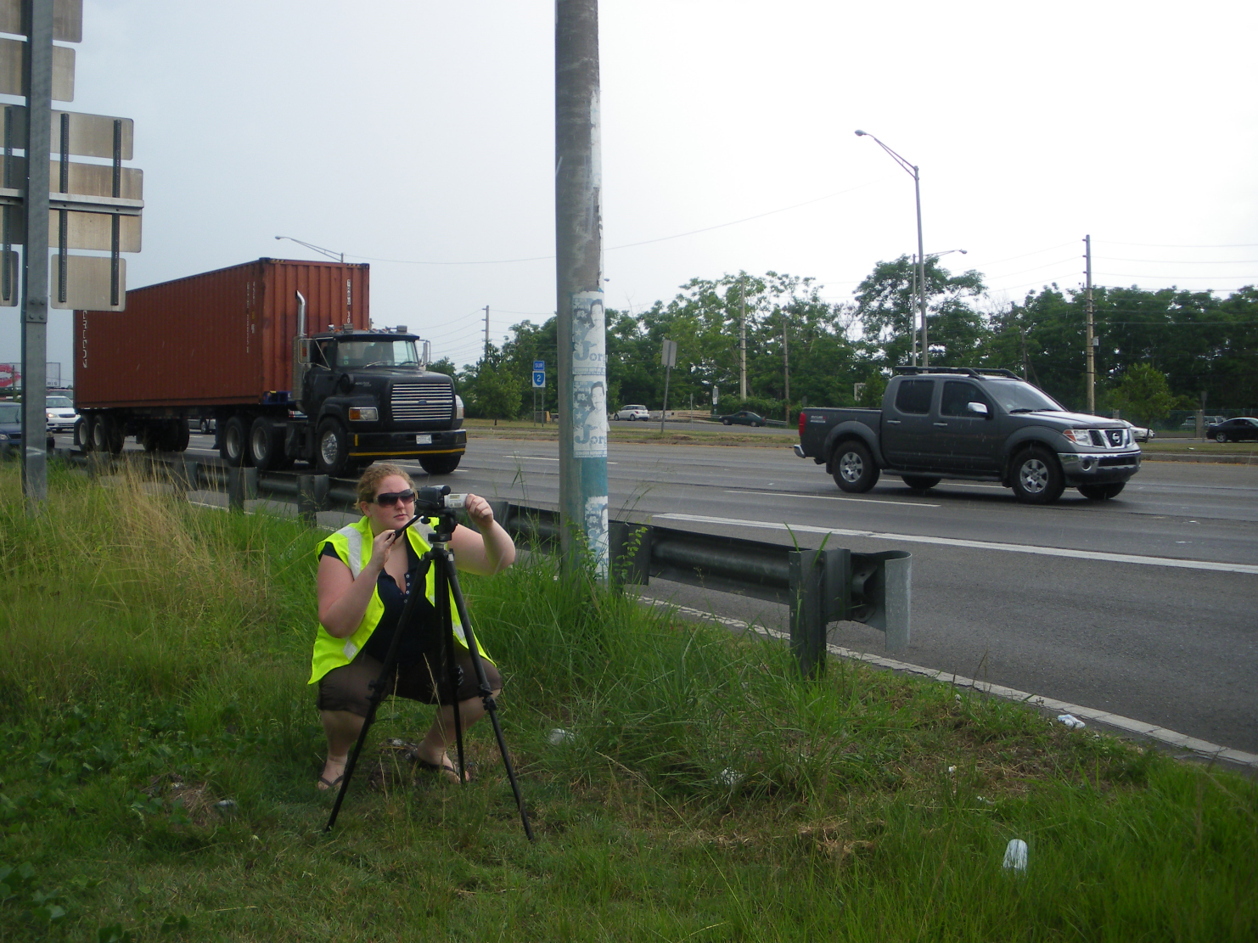
Video Recording each Approach
Each video had to include good visibility of the lights, the stop line, and all of the main traffic lanes.
Notes:
READ SLIDE:
The videos recorded were an hour apiece. One of the reasons why it took longer to complete the analysis of the intersections was tat we could not leave our video cameras alone, so we were limited in the ability of moving around to record data.

Slide 22
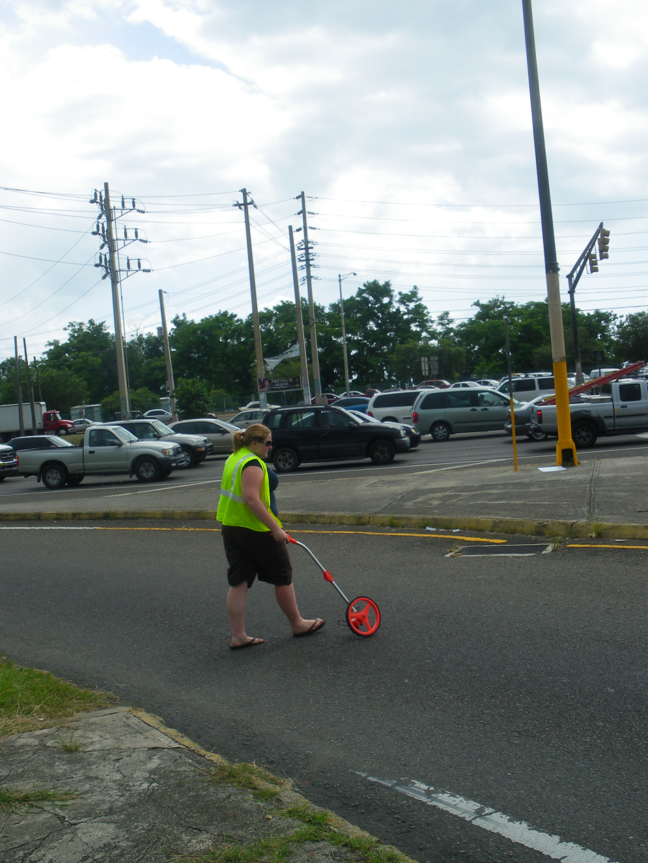
Determining the Geometry of the Approach
Measurements involved width, length, grades and lane type were all recorded.
Notes:
READ SLIDE.
All of the geomorty of al intersections is recorded in an overall grid.

Slide 23
Post-Field Analysis
Speed
Volume
Cycle Time
Red-Light Running
  And Yellow-Light Running
Notes:
The other 15% of my work was in the Post-Field Analysis which included:
READ SLIDE

Slide 24
Speed Data
The Speed Data collected in the field included;
  Distance (of vehicle from the laser gun)
  Car Type
    Sedan, SUV, or Pick-Up
    Heavy Vehicles were excluded from these measurements
  Speed
  Lane the vehicle was in
ALL data was taken from vehicles in free-flow
This is an example of the histograms created depicting the distribution of speeds of vehicles.
Notes:
As said before READ SLIDE
Graphs of all the speed data was collected in order to see the main speed of traffic.

Slide 25
Volume Data
Every five minutes, the total volume of each movement of vehicles and heavy vehicles (separately) was determined.
Movements included THRU, LEFT, and RIGHT
These are examples of the quantified results of the volume of vehicles passing THRU the said intersection.
Notes:
READ SLIDE:
These graphs visually show the volume of traffic after every five minutes.

Slide 26
Timing Data
Every approaches main thru lane’s light cycle was timed.
This included the times (in seconds) of the green, yellow, and red light lengths.
It has been shown that yellow-light times can effect the frequency of RLR incidents.
However, most yellow lights in Puerto Rico are 3 seconds long so this is not a factor affecting our data.
Notes:
READ SLIDE:

Slide 27
RLR Data
RLR Data is collected after reviewing the video.
Individual tallies of YLR and RLR number are totaled for each cycle.
The overall total is also determined for the one hour video.
RLR incidents are considered if they occur with vehicles travelling in the main (usually the THRU) lane.
YLR and RLR is determined to be when a vehicle crosses the stop line when the light is its respective color.
Notes:
READ SLIDE:

Slide 28
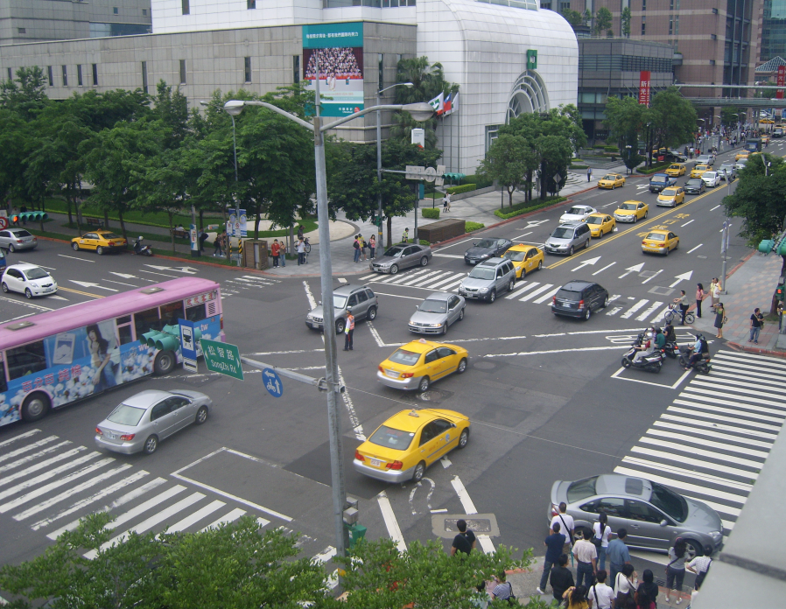
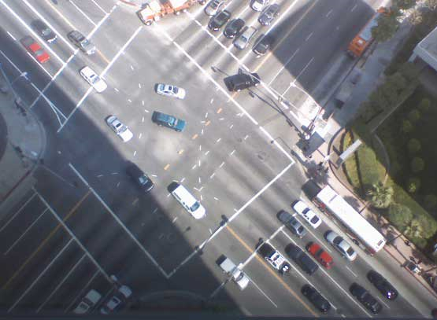
Analysis and Conclusions
Volume VS. YLR/RLR
Number of Lanes VS. YLR/RLR
Light Length VS. YLR/RLR
Notes:
For my analyses I compared YLR and RLR to the volume, number of lanes, and light, both (green and red) lengths.

Slide 29
Notes:
Both low volumes and high volumes are the minimums on this graph.
The lower volume there is on a road, the less likely it is that a vehicle will be approaching the stop line as the light is changing to red, decreasing RLR occurrences. The higher the volume is, the more likely there will be heavy traffic causing for lower speeds allowing a vehicle to stop for a red light in time, and be less likely to run the red light.
The maximums on this graph can be explained by
** The equations on the following graphs are basic modules for predicting red light occurrences. The function shows the amount of YLR or RLR occurrences with the volumes as the variable.

Slide 30
Notes:
Here I compared the number of lanes with the amount of YLR and RLR. The amount of YLR increased by 142% in this scenario when you added another lane. The amount of RLR increased 256% in this scenario when you added another lane. This directly correlates to the volume of traffic. IF there are more lanes, there will be more volume allowed; and as the amount of lanes increases, the amount of YLR and RLR increases as well. So this data is supporting that as the volume increases, so does YLR and RLR.

Slide 31
Notes:
If a main approach has short red light, it usually has a longer green light than the cross road because the total cycle lengths are both similar. That means that that cross road has short green lights and longer red lights.
As you can see on the graph, short red lights produce high RLR occurrences as well as long red lights. When a red light is short, the road is usually a main road (like PR 2) which has higher speeds and higher volumes than the cross road. This means that cars at higher speeds need more time to stop, and if there isn’t enough time, the vehicles will run red lights.
Longer red lights are usually found on cross roads where the volume and speeds are lower, but the green lights are shorter. If a red light is extremely long, this makes drivers aggravated and urges them to run red lights in order to not have to stop for another cycle.

Slide 32
Notes:
This graph directly correlates to graph comparing Red light Length with Light Running.
If the green lights are short, the red lights are usually longer causing more drivers to feel a need to get past the stop line in order to continue. If green lights are too long, usually the volume of the approach is high and so is the speed making it more difficult for drivers to come to a stop in time cause RLR occurrences.

